Slide 1

Online Expert Session
26/06/2025
Presented by: Natalia Conejo Andrés |
This work is licensed under a Creative Commons Attribution-ShareAlike 4.0 International License

Slide 2

Index
International an EU Framework for sustainability in TVET
Education, the key for sustainability
Integrating Green Practices in TVET:
best practice: Food sovereignty
best practice: Energy sovereignty
best practice: Waste Management and Circular Economy
sustain-it-project.eu
© 2025-2027 Sustain-IT.

Slide 3

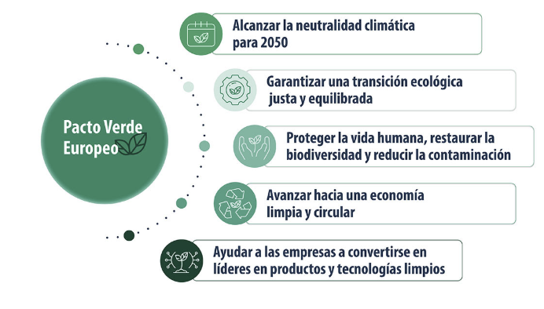
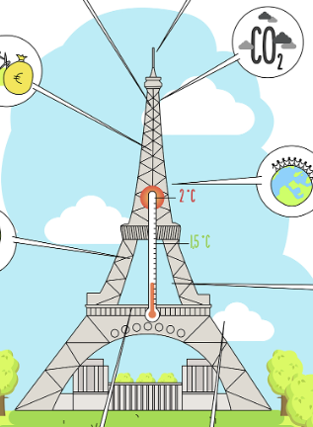
International an EU Framework for sustainability in TVET
2030 AGENDA
Achieving climate neutrality by 2050
THE GREEN DEAL
Just ecological transition
Protect human life, restore Biodiversity, reduce pollution
CURBING
CLIMATE CHANGE
Move to a circular economy
TVET AS KEY ELEMENT FOR TRANSITION
should take place in a short time.

Slide 4
















Integrating green practices in TVET.
Education and training
EDUCATION AND TRAINING
The key mechanism for sustainability and regeneration
COLLABORATION AND COOPERATION
REGENERATIVE ECONOMY
INTEGRATE DIVERSITY AND TAKING RESPONSIBILITIES
TECHNOLOGY
INNOVATION
RESOURCES
NATURAL. MANAGEMENT
RESTORATION
SUSTAINABLE
DEVELOPMENT
EDUCATION
El camino para el cambio a un desarrollo sostenible

Slide 5

Integrating green practices in TVET.
Education and training
TEACHER TRAINING is a basic pillar of the educational process.
The implementation of a DIGITALIZATION AND SUSTAINABILITY MODULE
in all VET cycles
A network of CENTERS OF EXCELLENCE

Slide 6
Integrating green practices in TVET.
Education and training
European recommendation on Vocational Education and Training for sustainable competitiveness, social fairness and resilience,
Knowledge, understanding and critical thinking
Empathy, solidarity and care for nature
Project-based learning
Erasmus+ CENTERS OF VOCATIONAL EXCELLENCE
( Educators, public, private stakeholders)
Project Cooperation with different TVET centers
El camino para el cambio a un desarrollo sostenible

Slide 7
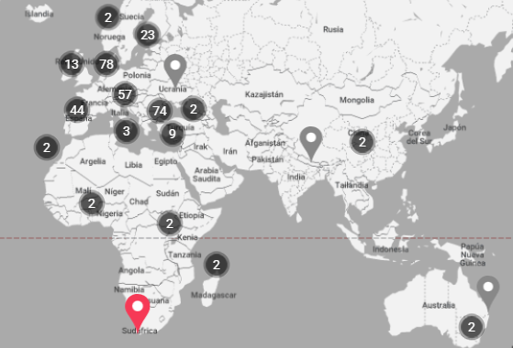
Integrating green practices in TVET.
Education and training
RECOMMENDATIONS AND METHODOLOGIES ON LEARNING ABOUT SUSTAINABILITY IN TVET
Project-based learning
Project Cooperation with different centers
Create or transform a company by drawing up a sustainability plan by applying concepts such as circular economy, climate change, nature restoration
Project cooperation with different stakeholders
( Educators, publics, private)
Erasmus K2
CF train in TVET
Learning to calculate Co2 emissions and taking actions to reduce it.
Different centres collaborate to improve school building efficiency, sustainable mobility
(CoP CoVEs) Community in Practice of centre of excellence
Internships in companies applying sustainability
Notes:
Becuase we want skilled professionals for transition towards a sustainable development

Slide 8
Integrating green practices in TVET.
Education and training
BEST PRACTICES FOR SUSTAINABILITY
FROM TVET TRAINING TO LABOUR MARKET IMPLEMENTATION
Waste/resource management and circular economy
Food sovereignty
Energy sovereignty
Notes:
Becuase we want skilled professionals for transition towards a sustainable development

Slide 9
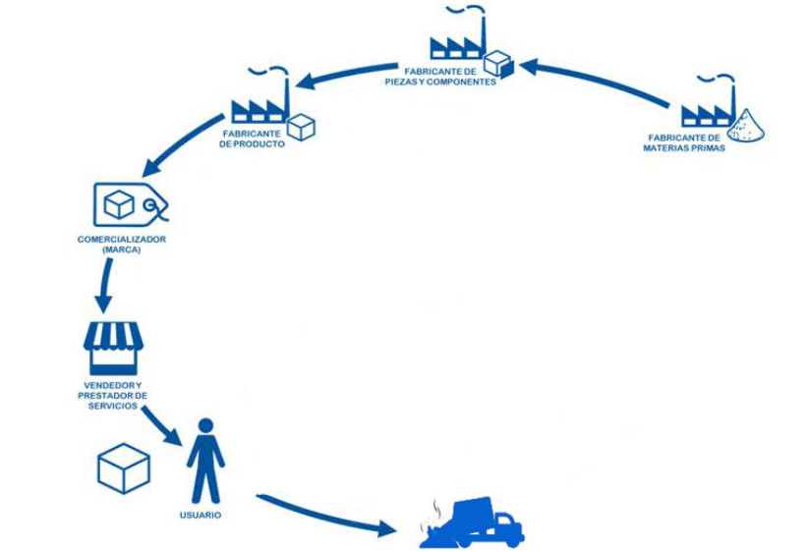
Waste/resource management and circular economy
Notes:
Becuase we want skilled professionals for transition towards a sustainable development

Slide 10
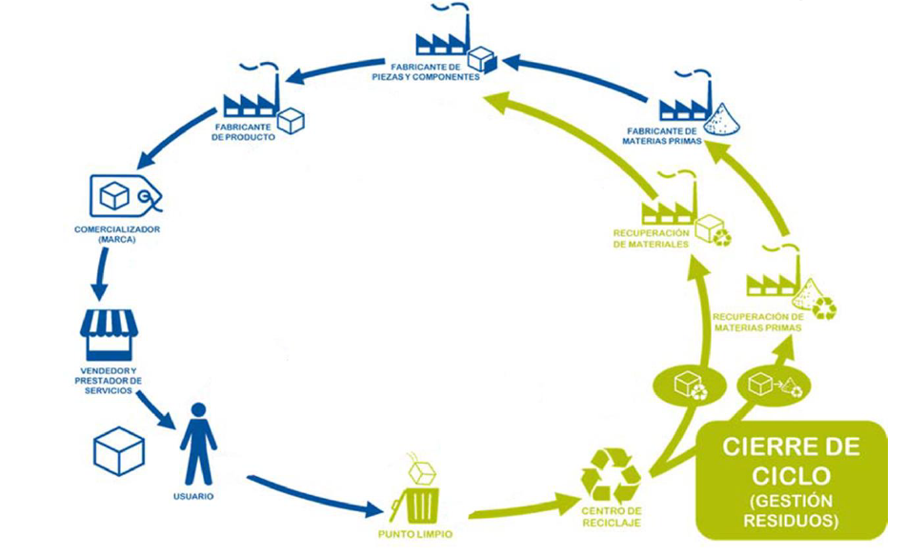
Waste/resource management and circular economy
Notes:
Becuase we want skilled professionals for transition towards a sustainable development

Slide 11
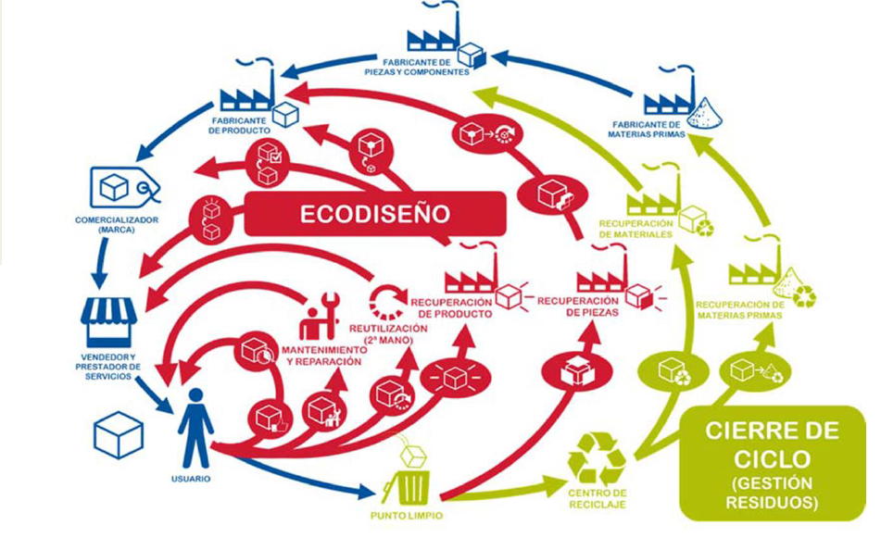
Waste/resource management and circular economy
Notes:
Becuase we want skilled professionals for transition towards a sustainable development

Slide 12
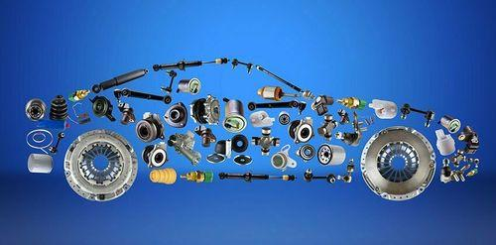
Waste/resource management and circular economy
Recycled,
Easy to obtain, local,
Recyclable,
Harmless
REMANUFACTURING
Reuse. parts
Materials
Functionality
Efficiency
RECYCLE
Disassemble
(parts and materials)
INNOVACIÓN-COLABORACIÓN
Water
Energy
Resources
Recover
Innocuousness
DESIGN
Service instead of purchase
End of life
Recyclability
Product
Repairability
Maintain
Reuse
Repair/ Reburbishing
FUNCTIONAL USE
Durability
EFFICIENCY.
Use less, use better, longer

Slide 13

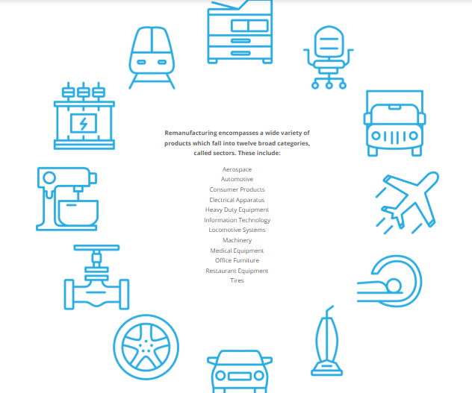
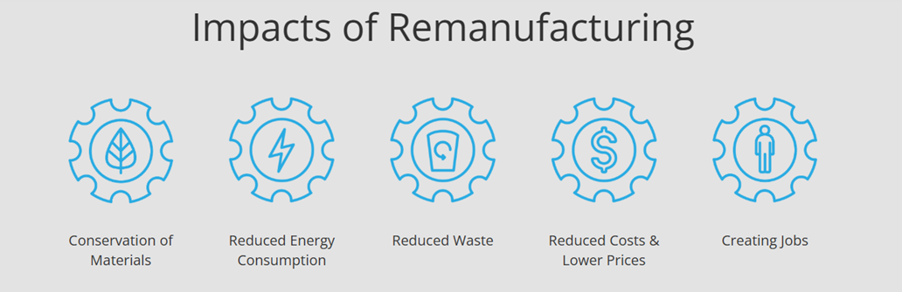
BEST PRACTICES: CIRCULAR ECONOMY
TECHNICAL CYCLE
A FOCUS ON USED VEHICLES
Used vehicles dominate the African market and are therefore important to the automotive industry’s circular economy transition and economy
Applying the circular economy principles to the automotive remanufacturing industry
REPAIR, REBURBISHING/ REMANUFACTUTING
keeping components and their embodied material in use for longer, not only avoid waste, emissions to air and water and heavy extractions,
it is about green jobs and a rising economy towards sustainable development
Electrical aparats
Machinery
Medical equipments
computers
Haevy duty equipments
Locomotive systems

Slide 14
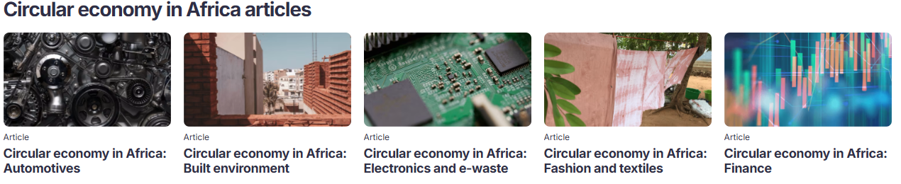

BEST PRACTICES: CIRCULAR ECONOMY
CIRCULAR ECONOMY IN AFRICA

Slide 15
Best practices: Waste Management
CIRCULAR ECONOMY IN AFRICA
Sole Rebels in Ethiopia makes shoes out of recycled tyres, indigenous plant fibres, and local leather. Sole Rebels has global reach, stores in North America and Europe, and an annual revenue of USD 22 million
Nigeria’s Planet 3R weaves discarded plastic water sachets into bags, homewares, and accessories. Employs 16 full-time staff after less than 3 years in operation, and secured USD 100,000 funding to expand.
Nairobi-based Rummage Studio sources 95% of the core materials in its bags and accessories from the largest second hand textile market in East Africa

Slide 16






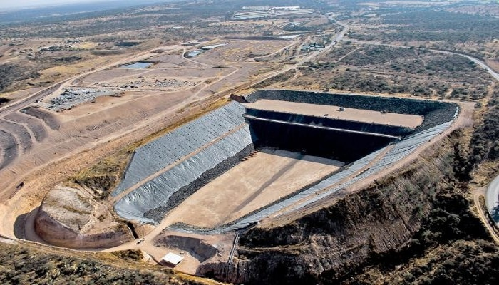





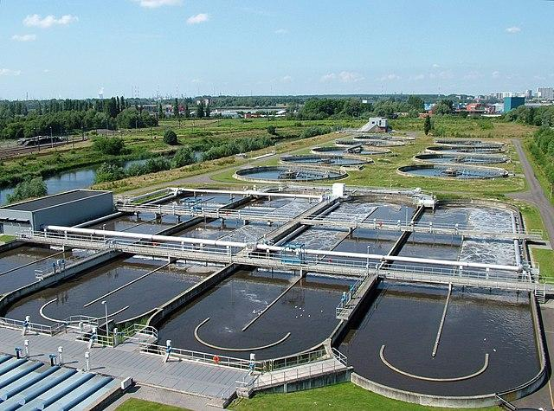
BEST PRACTICES: CIRCULAR ECONOMY
BIOLOGICAL CYCLE
EROSION
PESTICIDES
CHEMICAL FERTILIZERS
WATER SCARCITY FLOODS
RUNOFF AND POLLUTION
Transporte
TRADITIONAL AGRICULTURE
Manufactura alimentaria
Relleno sanitario o vertederos
Transporte
Planta depuradorade agua (EDAR)
RESIDUOS
Tienda
Consumidor

Slide 17


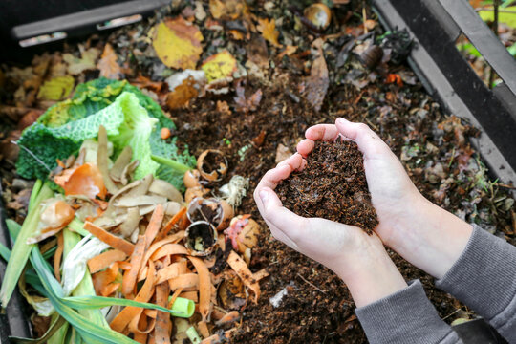

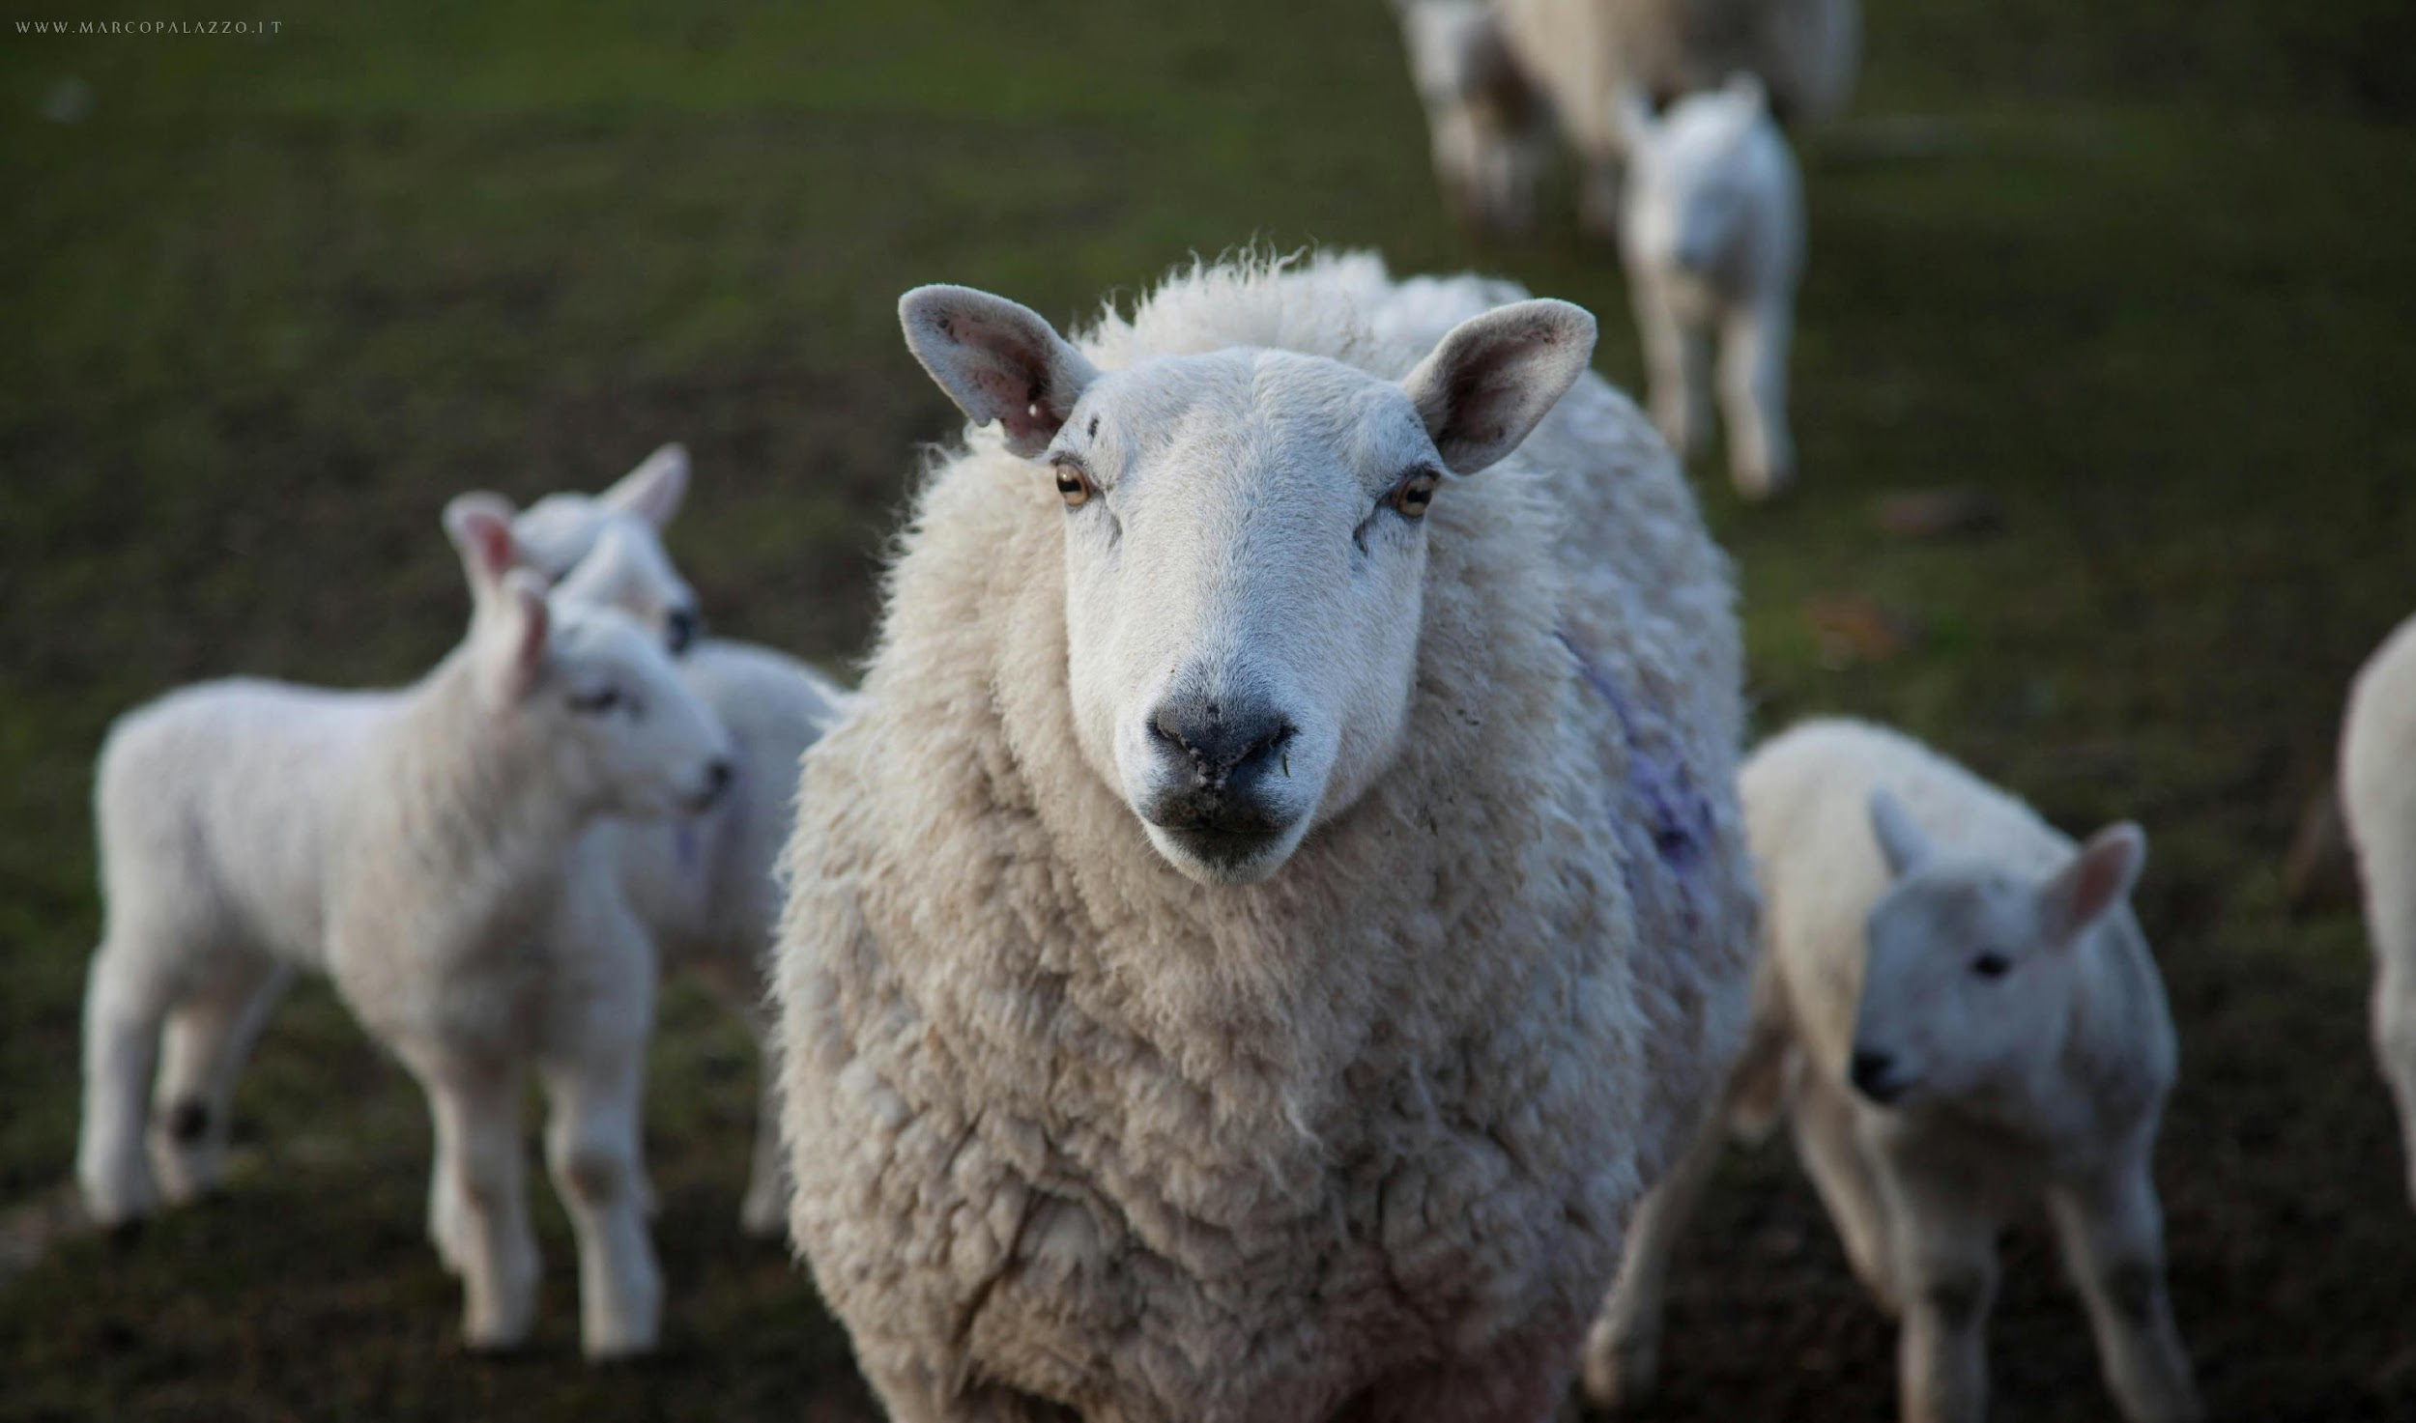
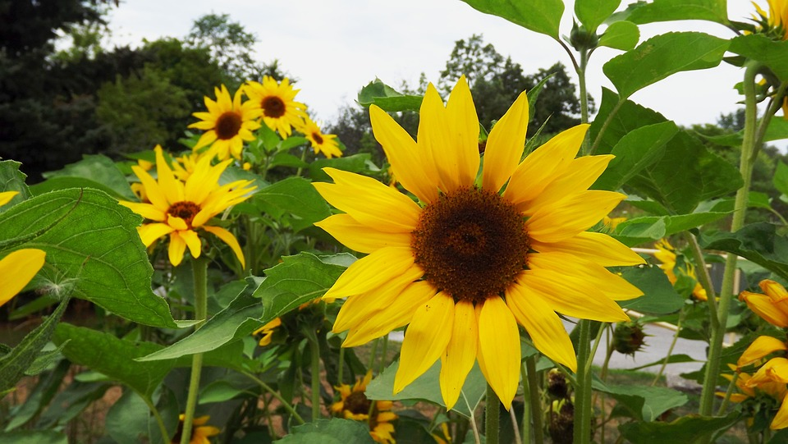

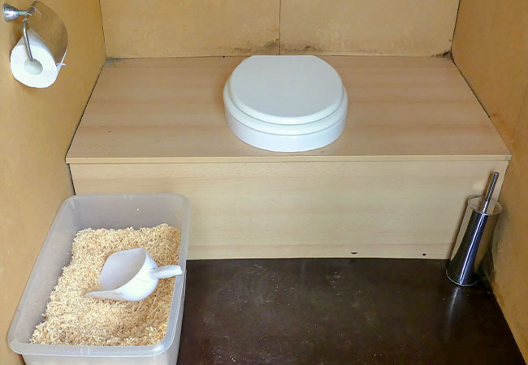
BEST PRACTICES: CIRCULAR ECONOMY AND FOOD SOVEREIGNTY
Rainwater collection on roofs
LIVING SOIL
BIOLOGICAL CYCLE
PESTICIDES
CHEMICAL FERTILIZERS
REGENERATIVE AGRICULTURE
EROSION
Canalizations and ponds for retention and water control
RUNOFF AND POLLUTION
Transporte
Compost
Holistic management for soil and animal health
Green roofs
Manufactura alimentaria
Transporte
Shop
Consumer
Compost

Slide 18

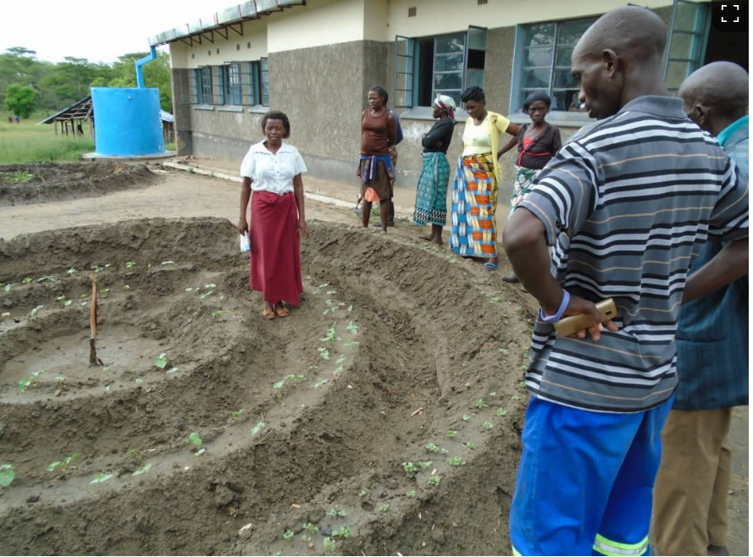



BEST PRACTICES: FOOD SOVEREIGNTY
Training a New Generation to Create Resilient Livelihoods
Through Permaculture Farming
Solar pump
SOLAR PUMP

Slide 19
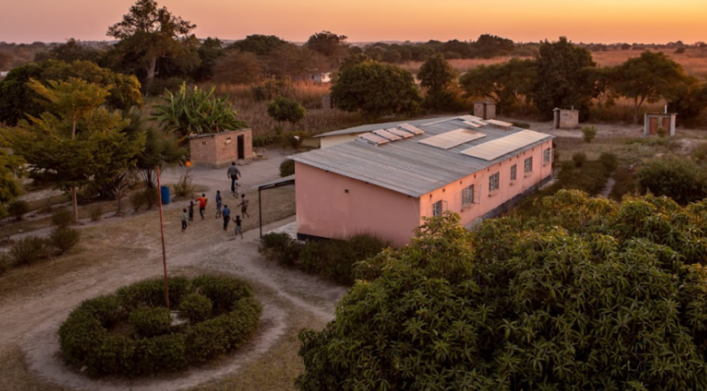
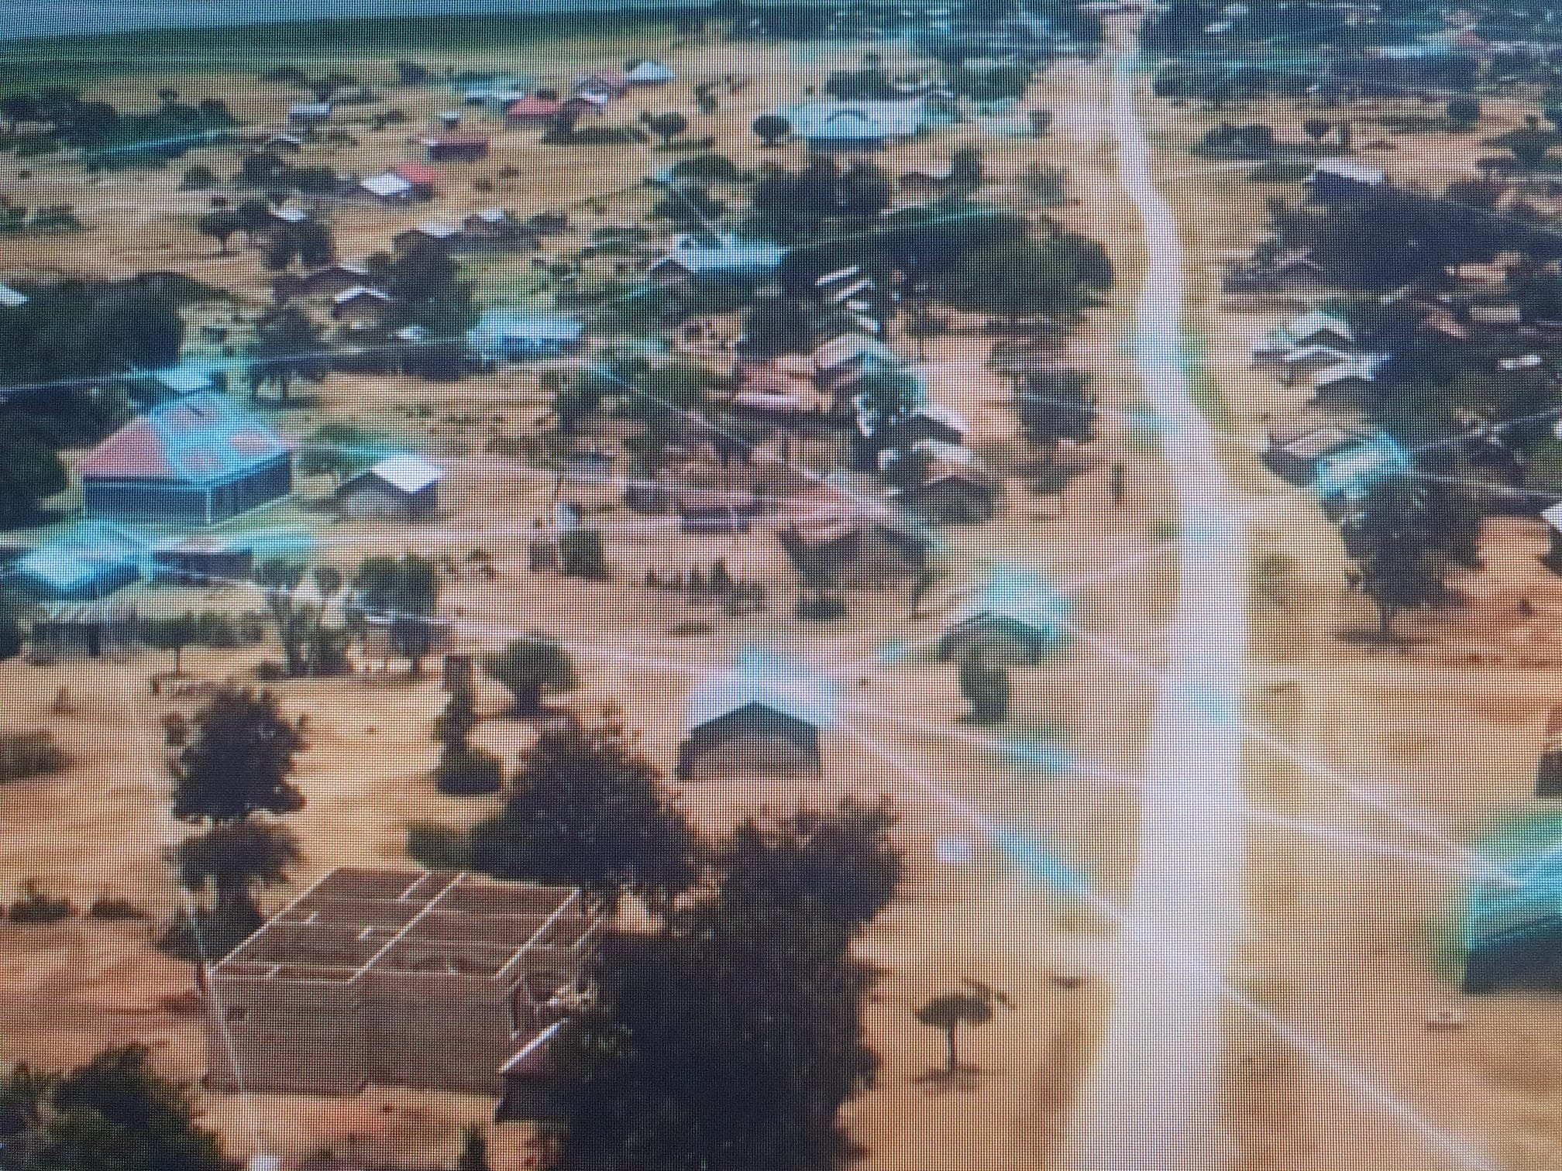
BEST PRACTICES: ENERGY SOVEREIGNTY
MICRO ENERGY GRIDS

Slide 20

Thank you

